Slide 1
Text Data Dashboard feedback
PGI/GKS

Slide 2
Two studies
Pillsbury Product Mini cinnamon rolls
Goal: concept product fit; product optimization
Study design: 2 sample horserace
Open text questions :
What do you like about the product? relates to Overall Liking
What would you change? relates to Overall Liking
Nature Valley Savory nut crunch bar
Goal: concept product fit; product optimization
Study design: 3 sample horserace
Text open ends:
1) How well does it meet your expectations? (related to meets expectations question)
2) What do you like about the product? (relates to Overall Liking)
3) what would you change? (relates to Overall Liking)

Slide 3
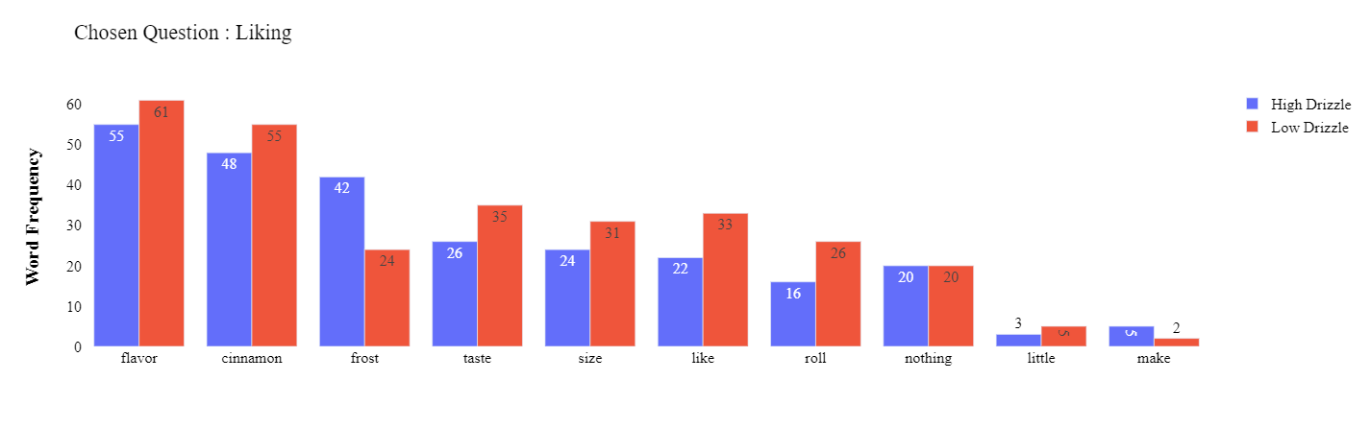
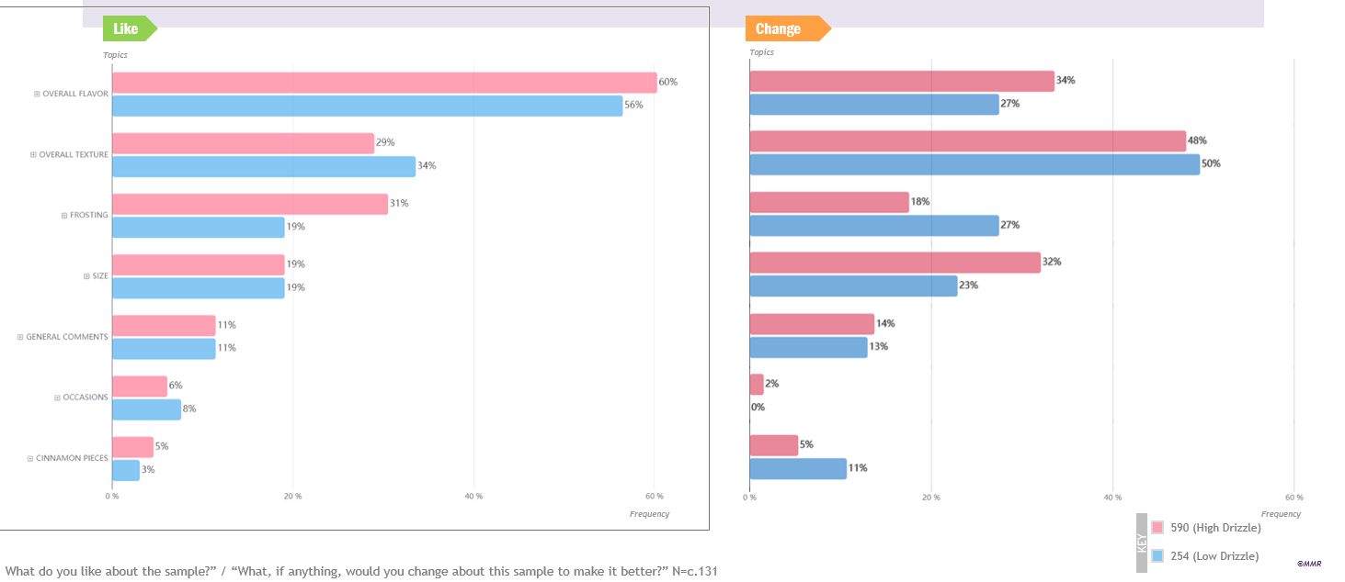
‘Top 10 most frequent words used - Word Frequency’ is a helpful section to quickly narrow down which words to look deeper into.
It’s not super helpful when words like “make” or “roll” end up in the top 10. Wondering if there would be a way for the scientist to manually ‘remove’ one of the selected top 10 words and it would get replaced by ‘word 11’? If that makes sense?
Texture doesn’t even make the top 10 list, probably since consumers were using different words to describe the texture. So the top 10 words list could be mis-leading?
More helpful and meaningful to have categories tabulated rather than individual words out of context –can quickly establish that people talked about flavor the most, followed by texture, frosting, etc.
MMR

Slide 4
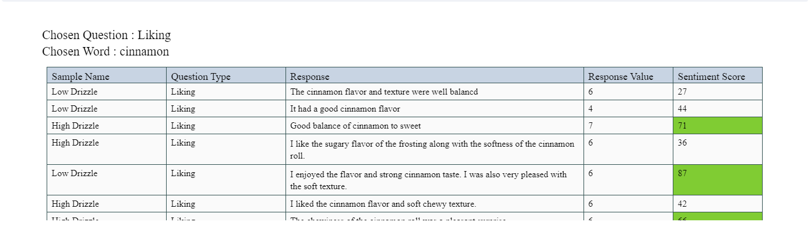
Tabular view for top 10 words with sentiment
Tabular view for top 10 words with sentiment (sentiment score is indicative)’:
Generally, the sentiment score of the individual text is not useful. If I’m reading those individual comments anyway, I can assess the sentiment.
It would be MUCH more helpful to have an overall sentiment score for each sample so we could see at a high level, for that text comment, are people speaking more or less positively about the samples.
Sentiment score also seems off – with some high response values having low sentiment.

Slide 5
Text Data Dashboard
The ‘co-location’ didn’t really end up being that useful. It wasn’t quite enough context for me to understand what the comment was, so that’s when I ended up just using the tabular view for the top 10 words with sentiment to see the full text comment.
Collocation, ‘Sentiment – Question’ and Sentiment Average are not as useful to display with teams

Slide 6
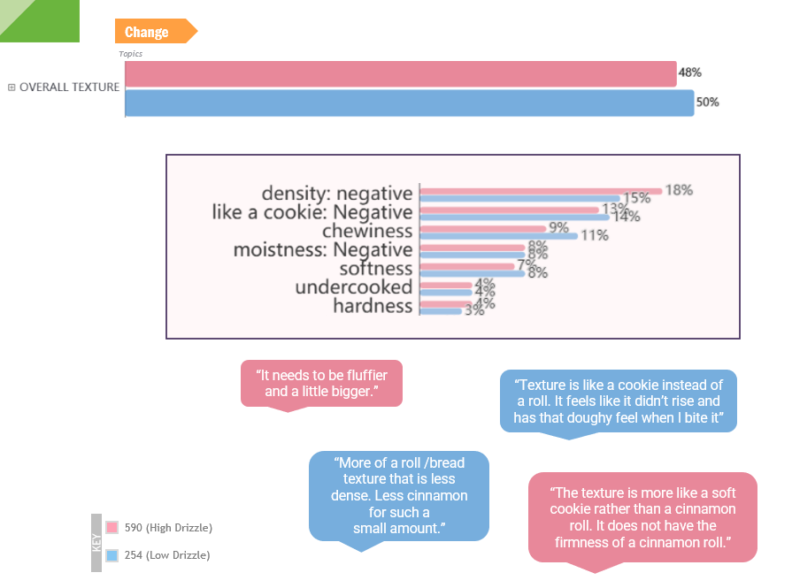
Additional Ideas
MMR
More helpful and meaningful to have categories tabulated rather than individual words out of context –can quickly establish that people talked about flavor the most, followed by texture, frosting, etc.
Can broader categories be broken down into more specifics? Again, more helpful to have it tabulated and in % form rather than in a table with each individual comment.
6

Slide 7
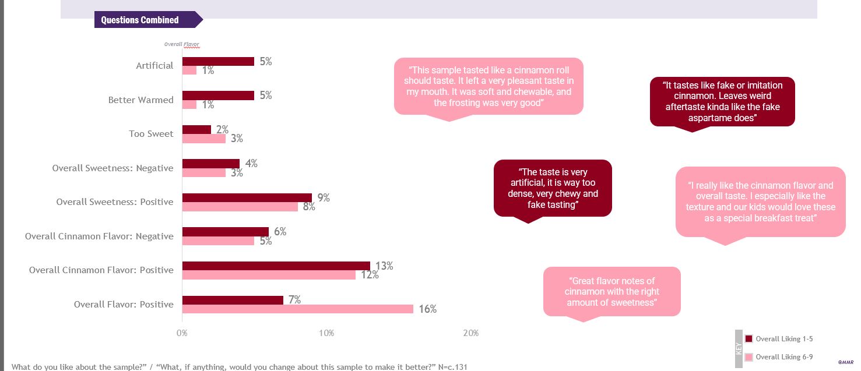
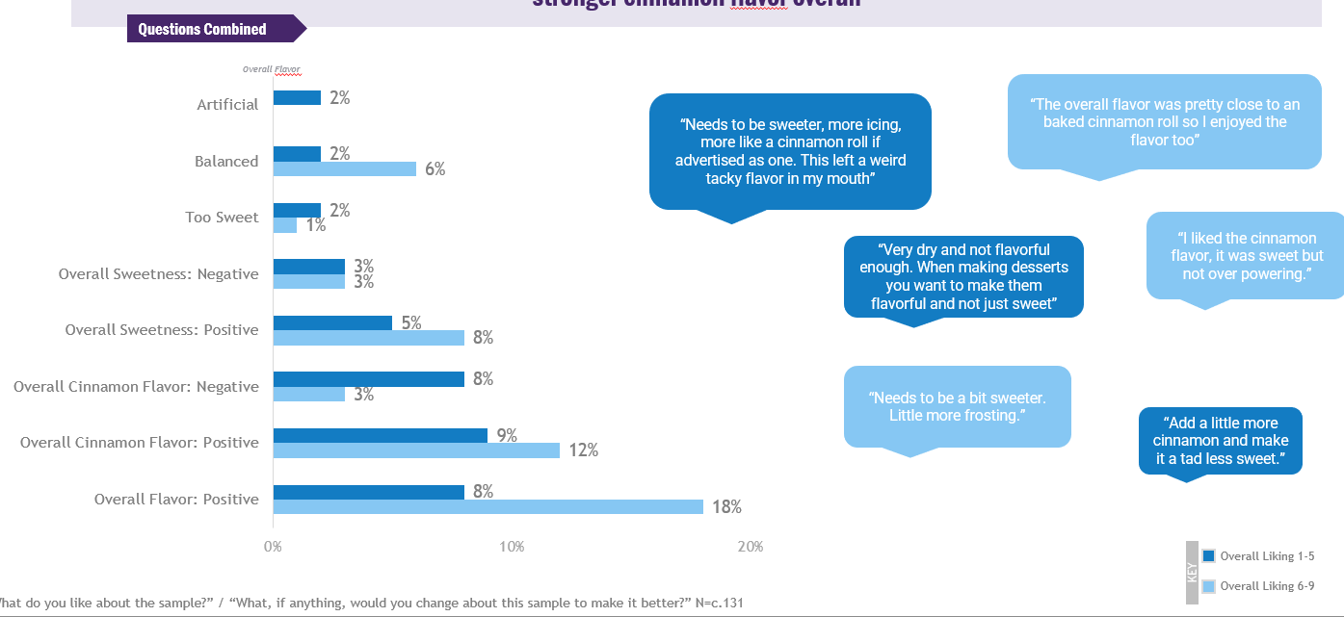
Additional Ideas
For each word - be able to separate out the tabulations and percentages for the different liking scores.
They’re also adding the sentiment onto these tabulations rather than how our tool is assigning a sentiment to individual comments, which is not very helpful.

Slide 8
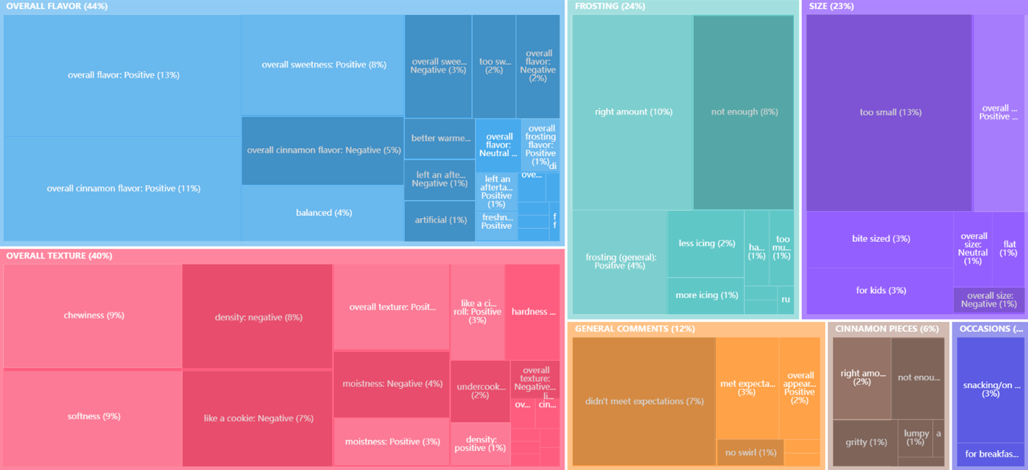
Additional Ideas
This is an interesting visual -shows the components of each overall topic, and that the box is the relative size of what % of consumers talked about that topic.
Maybe more of an overview tool for the scientist rather than for a report, but an interesting way to visualize it all.

Slide 9
In Summary
Overall, we find it value added to get a bird’s eye view of the text data and the broad trends in it.
However, we think it can be improved to make even more business impact!
Is there ability to take out words that are not useful (like, make, etc.) and can we further categorize into flavor, texture, appearance, etc.?
Does this require some ‘human intervention’ to help pull out non-meaningful words and create the categories?
Can we build displays off these categories
Can we leverage a more accurate sentiment analysis tool?
Google Bert?
We’d recommend removing sentiment score graphs (Top 10 most frequent words used - Sentiment Average and Sentiment – Question)
Can we replace the above with other charts that are more meaningful?
Charts that display separated out tabulations and percentages for the different liking scores (1-5, 6-9).
Tree Map

